Slide 1

Slide 1
Natural Disasters
GROUP 1
Christian, Le, and Richard

Slide 2
Executive Summary
The scope is natural disasters in the 21st century to date
The source is the US National Oceanic and Atmospheric Administration via their National Centers for Environmental Information website (link)
The requirements for a data visualization project were:
At least 100 records
A database to house the data
Visual deliverables
Usability
This project resulted in
1800+ records retrieved
A MongoDB database
Three unique visualizations
Future usability of code and visualizations
Notes:
Richard

Slide 3

Project Goals
Retrieving 21st century data on natural disasters
Cleaned data housed within a flexible database
Visualizations to identify natural disaster events and key characteristics (i.e., event details and locations; damage figures; fatalities; etc.)

Slide 4
Datasets
National Oceanic and Atmospheric Administration
National Centers for Environmental Information
Earthquake events
Tsunami events
Volcano events
Over 1800 unique events retrieved via API

Slide 5
Order of Operations
NOAA
Website
3 JSONs
- EQ, TS, & VC
Export JSONs
Convert to geoJSONs
Generate visualizations
Data Cleaning via pyMongo
Import to Mongo

Slide 6
Bar Chart

Slide 7

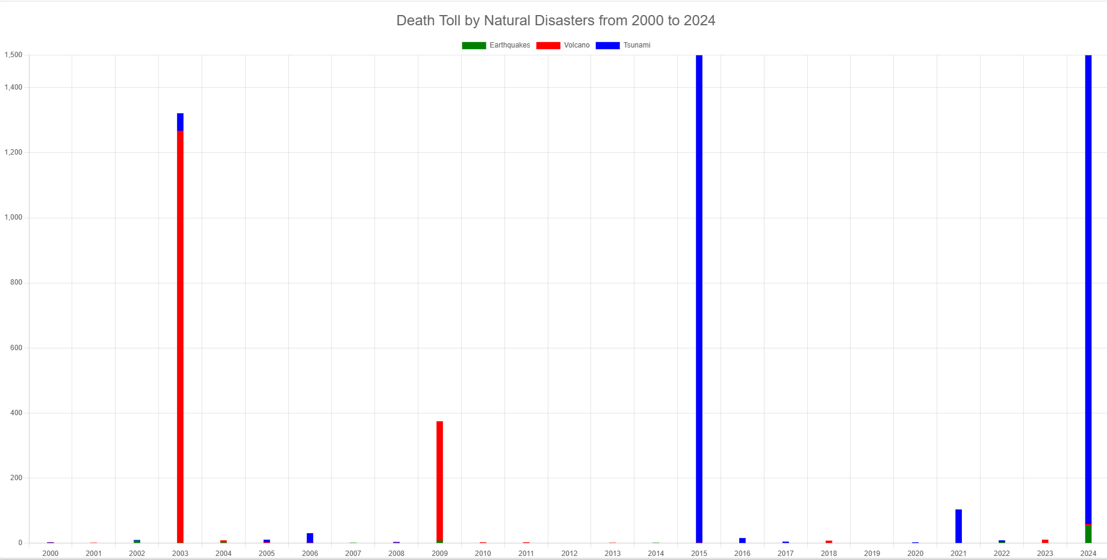
Slide 10
Chart JS Bar Chart of Death Toll of Natural Disasters in the 21st Century
Visualize the values in the datasets
Compare three different datasets
Display any trends found in the data
10

Slide 8
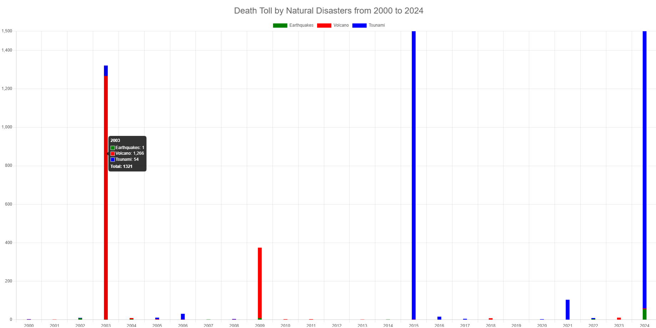
Interactivity
By scrolling over each bar, users are able to see the distribution of each year, split between Earthquakes, Tsunamis, and Volcanoes, as well as the total for each year
Two bars, in the years 2015 and 2024, exceed the top of the chart, as they were outliers compared to the rest of the data
Each section of the bar is a different color, which represents each natural disaster type’s contribution to the total

Slide 9
Findings
In most years of the 21st Century, natural disasters have caused less than 20 deaths across the world
There have been a few major events that caused many casualties
Tsunamis caused more than 99% of the deaths in the 21st Century when taking the totals of volcanoes, tsunamis and earthquakes

Slide 10
Heat Map

Slide 11
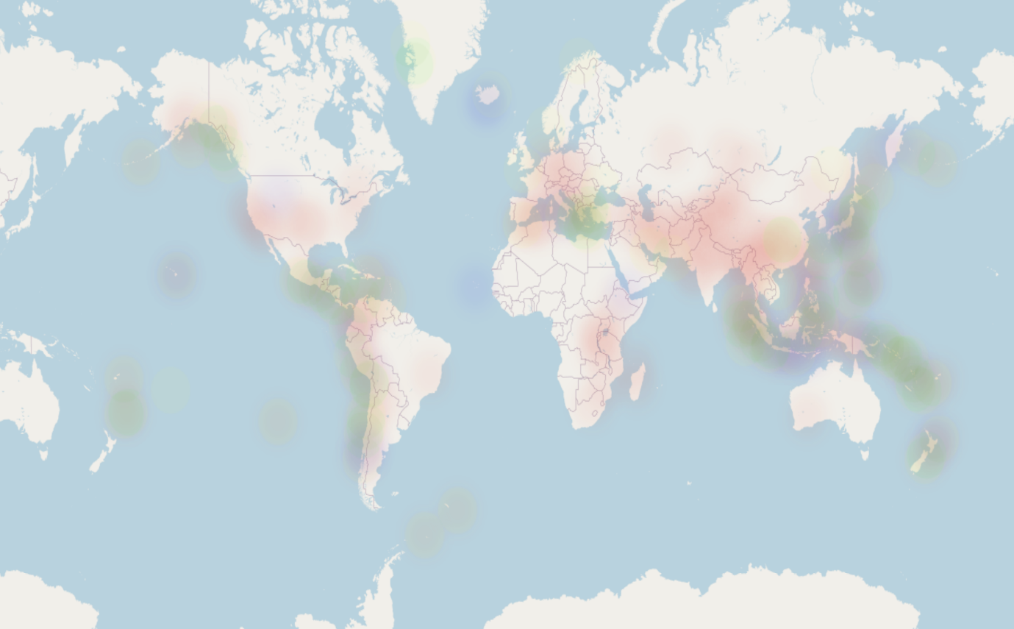
Slide 10
Heatmap Visualization of Global Natural Disasters from 2000 to current
Represent the frequency of the data points
Provides an immediate visual summary of information, allowing for quick identification of patterns, and trends
Identify trends and patterns, and highlight areas of interest
10

Slide 12
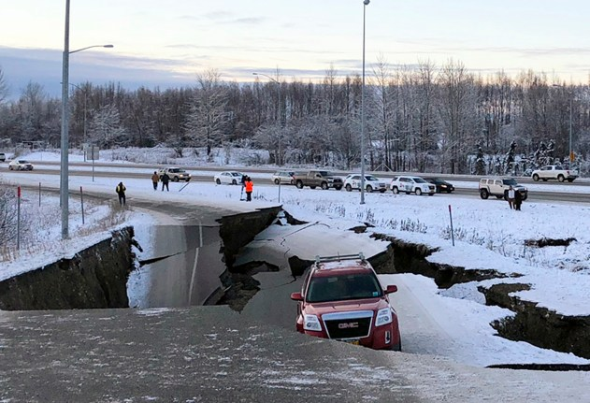
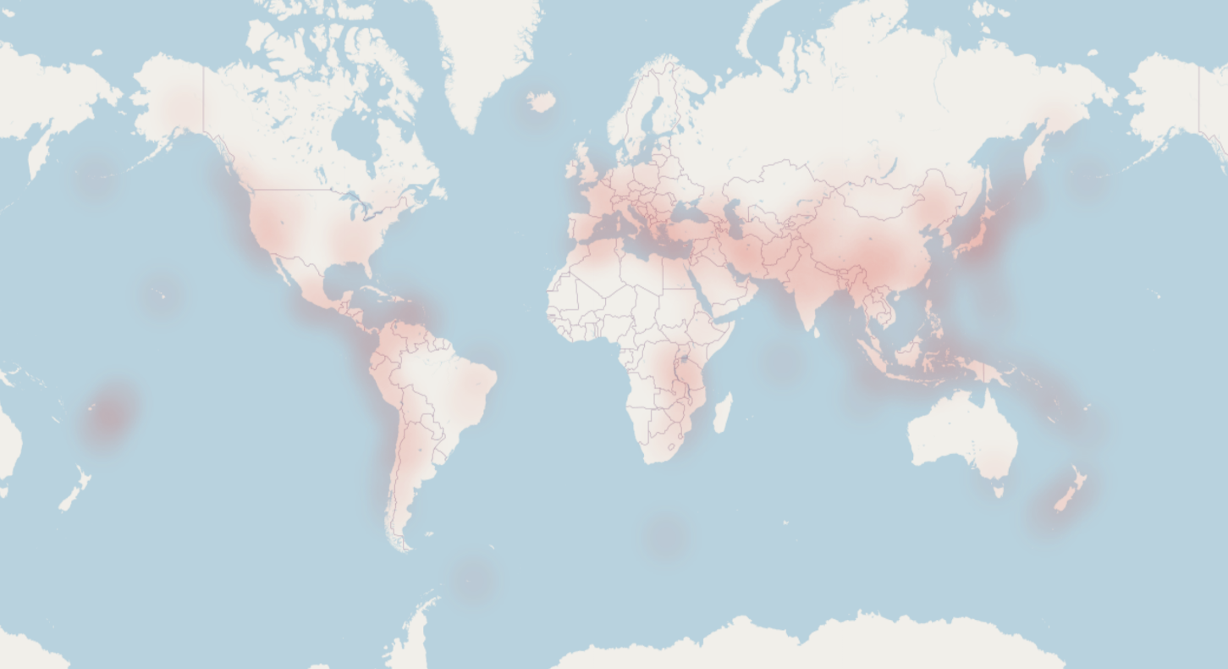
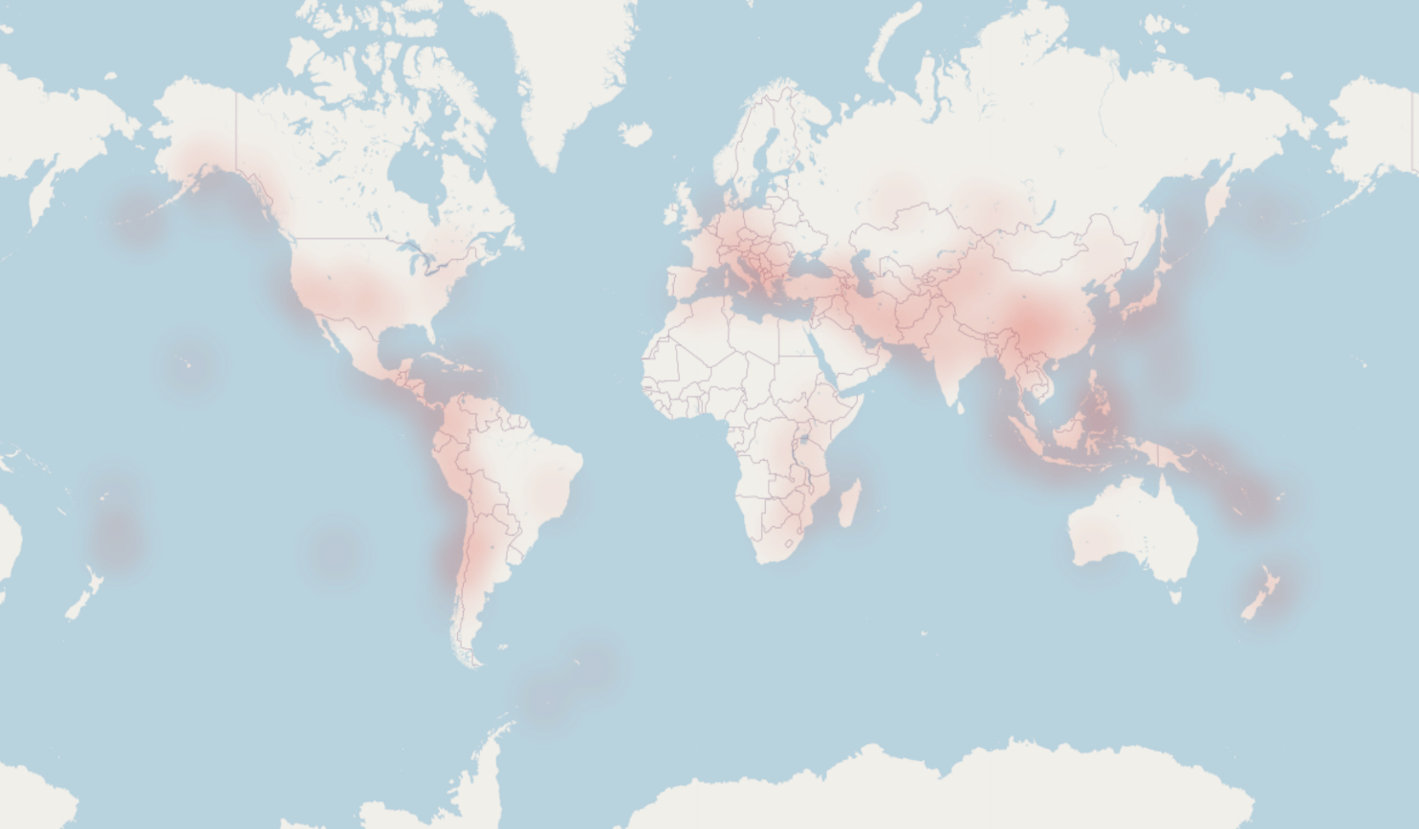
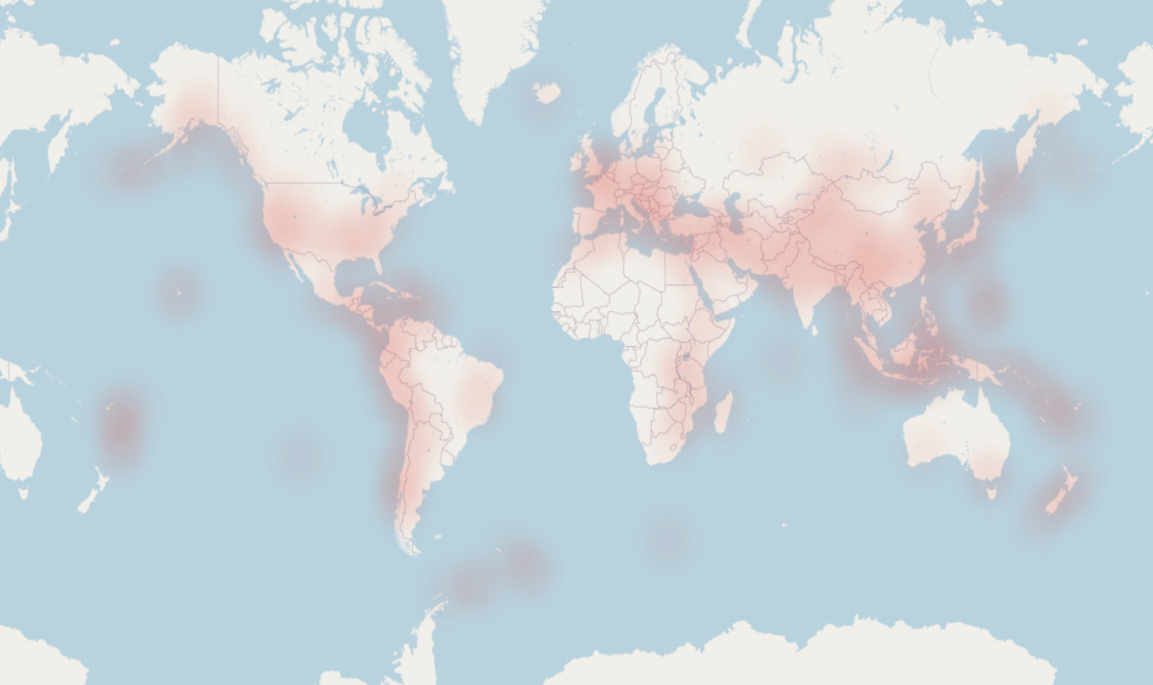
Earthquakes (2000 to current)
2000s
https://cms.accuweather.com/wp-content/uploads/2018/12/alaska-crumbled-road-earthquake-1.jpg?w=632
2010s
2020s

Slide 13
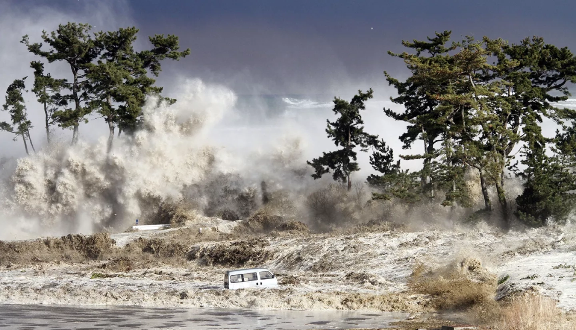
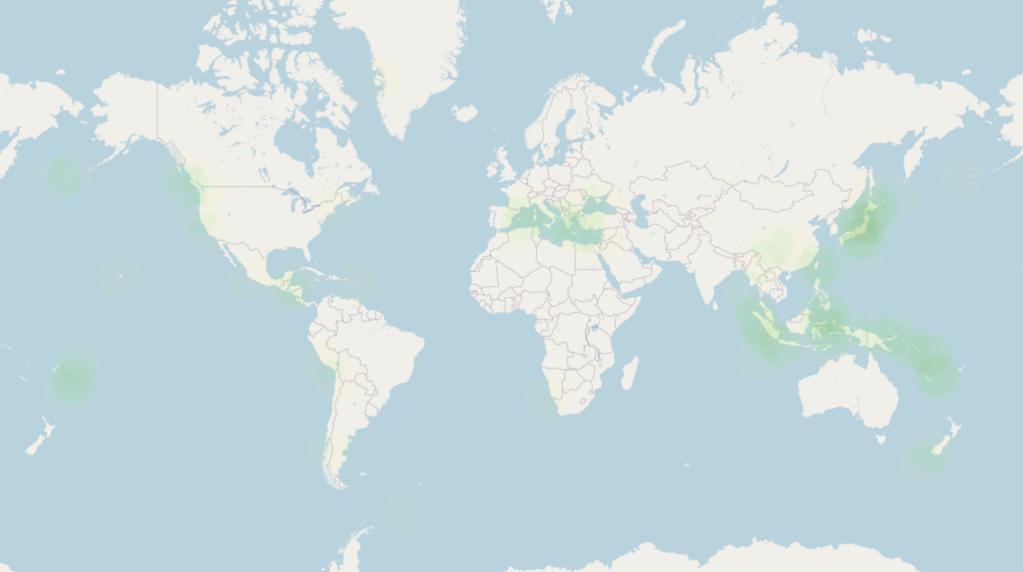
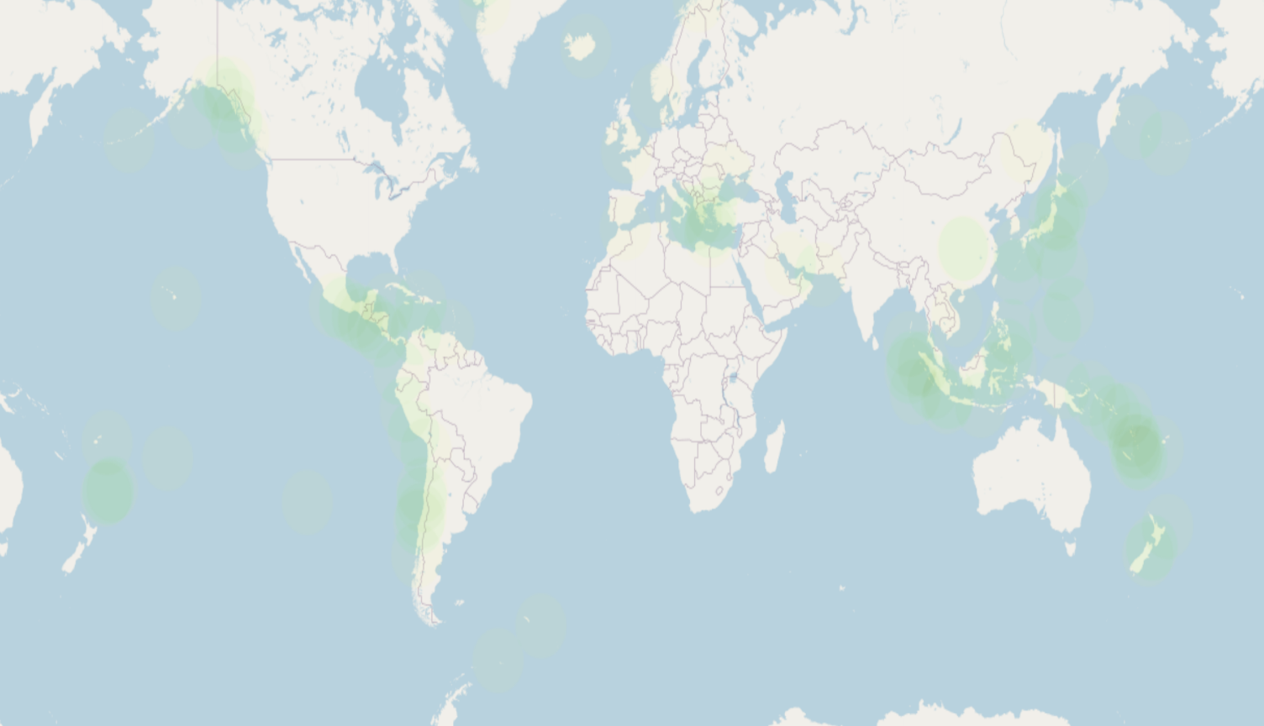
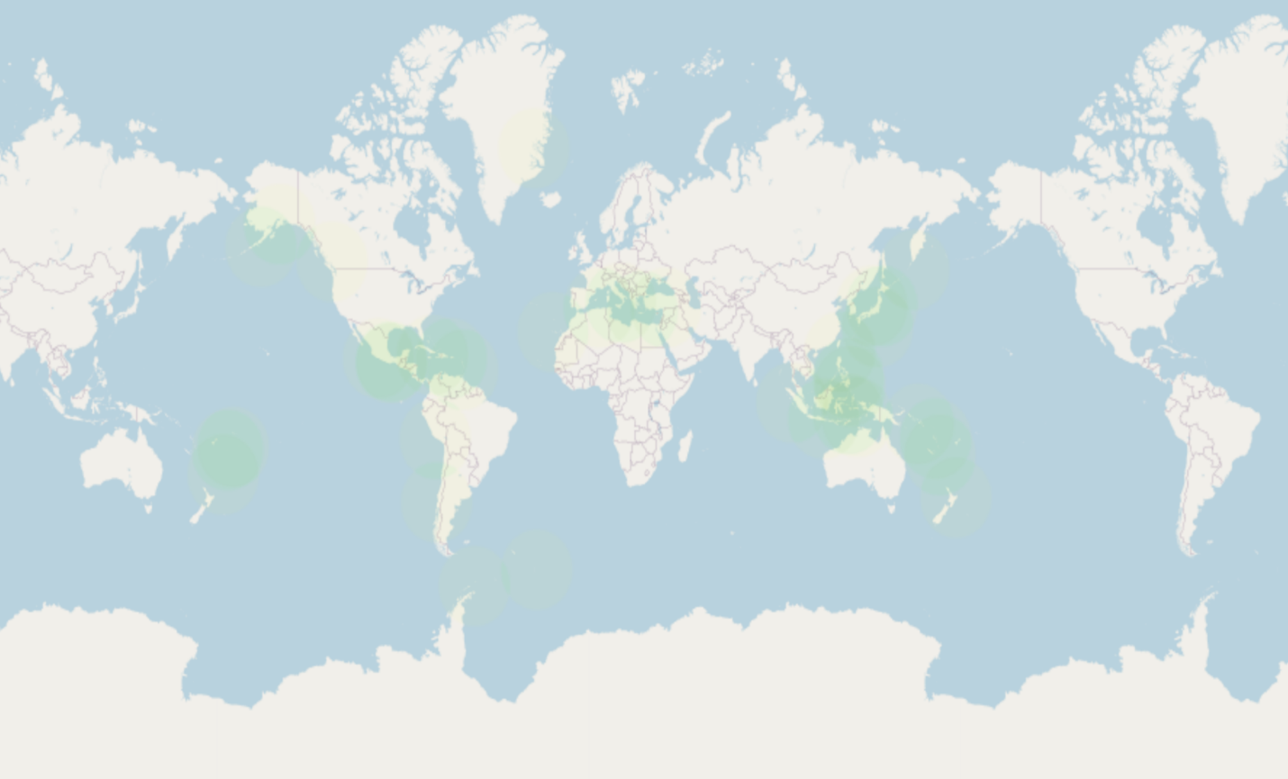
Tsunamis (2000 to current)
2000s
https://appliedsciences.nasa.gov/sites/default/files/styles/homepage_hero/public/2021-03/tsunami-hires.jpg.webp?itok=XMQ24DFx
2010s
2020s

Slide 14
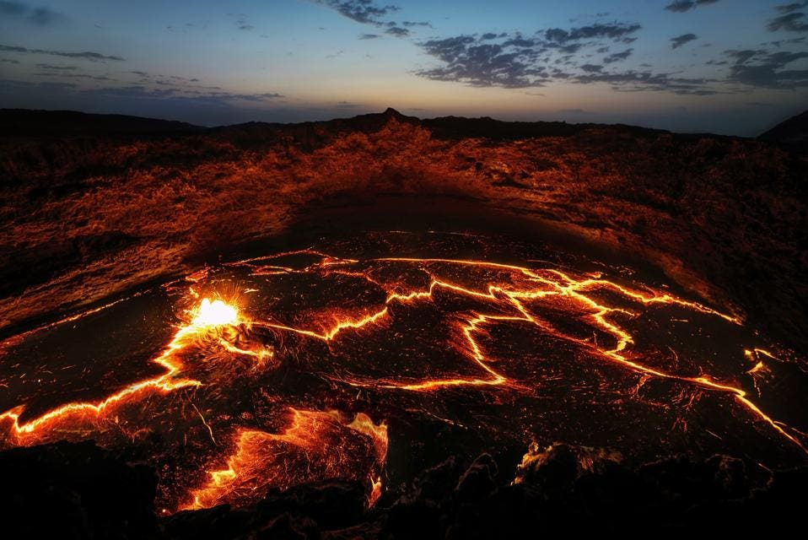
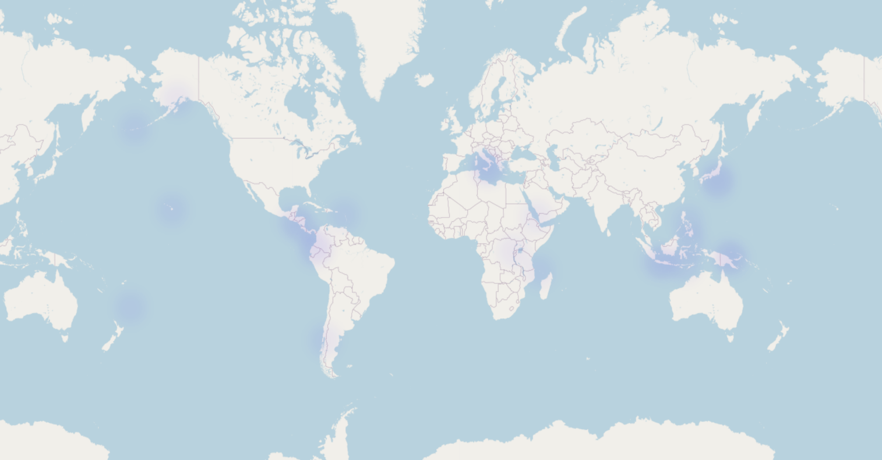
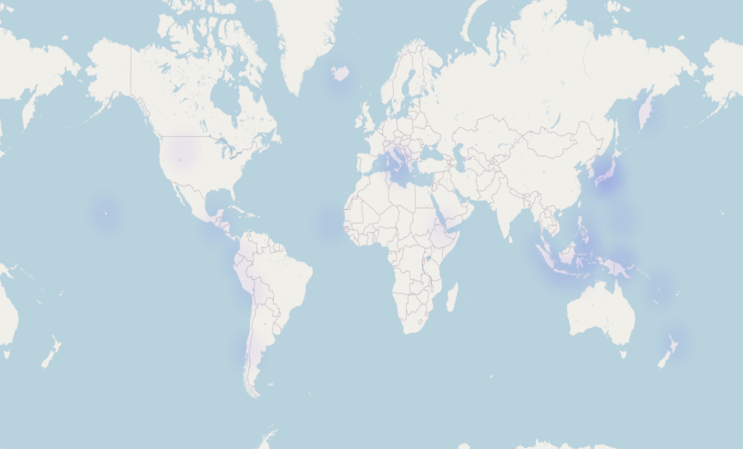
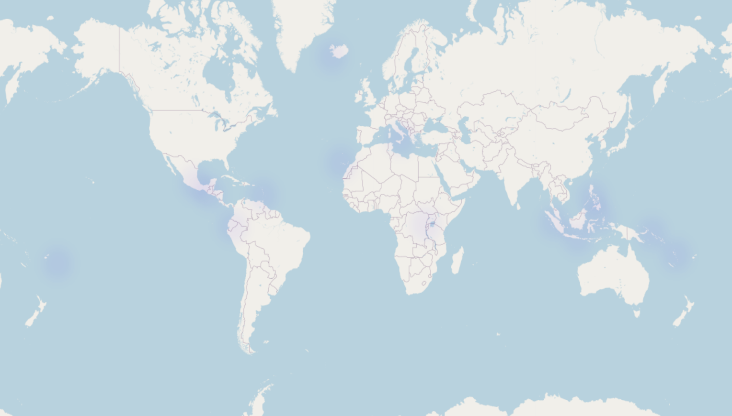
Volcanos (2000 to current)
2000s
https://imageio.forbes.com/specials-images/imageserve/60709b65ba4f467ef8aa94c9/Erta-Ale-Volcano-Ethiopia/960x0.jpg?format=jpg&width=1440
2010s
2020s

Slide 15
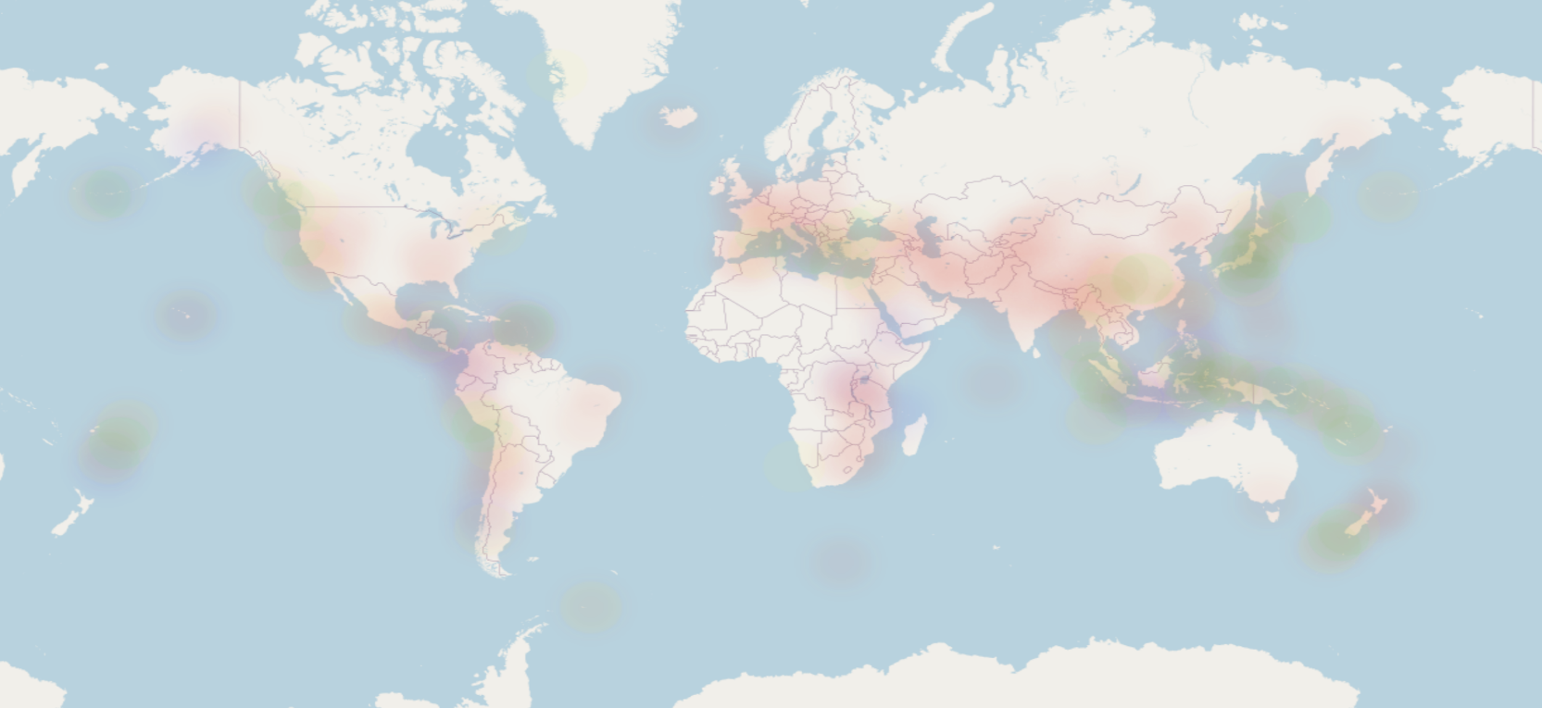
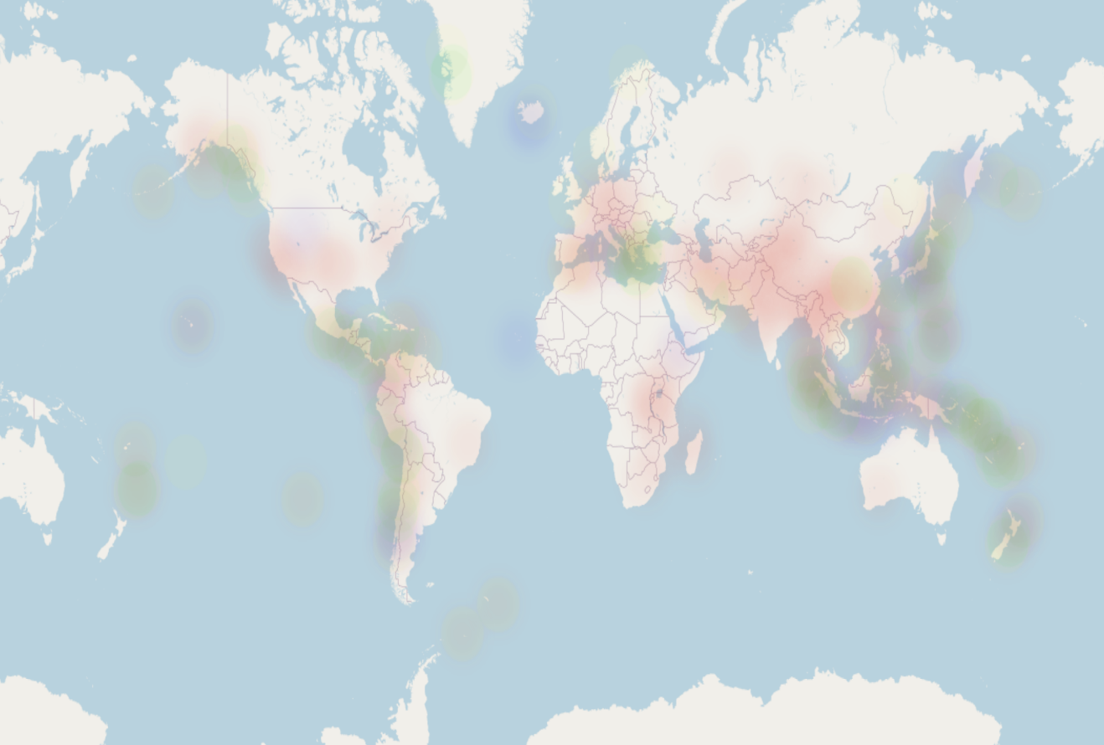
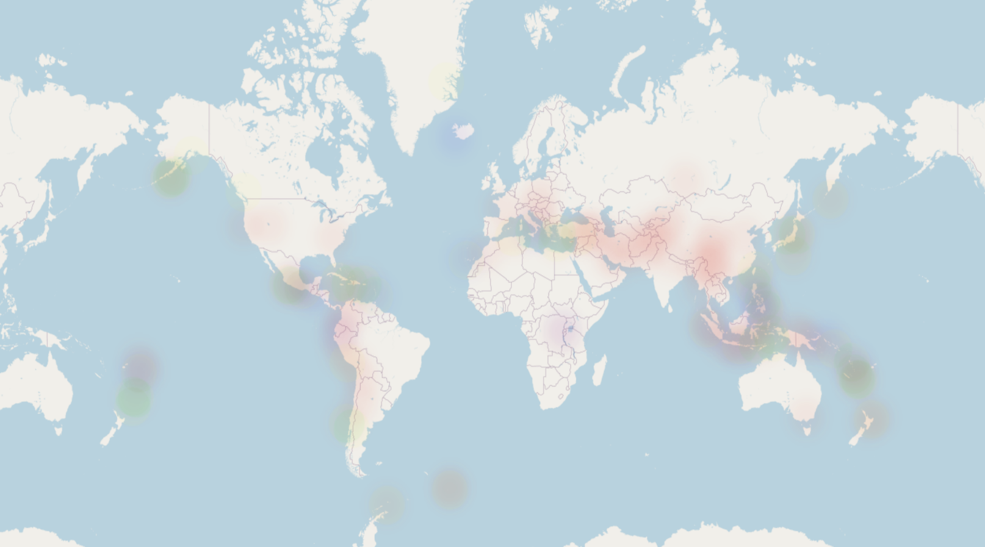
Combination of Earthquake, Tsunami and Volcanos in each decade The frequencies of each disaster: - Central America - Japan - South China Sea and East China Sea - Indian Ocean (Indonesia)
2000s
2010s
2020s

Slide 16
Layered Map

Slide 17
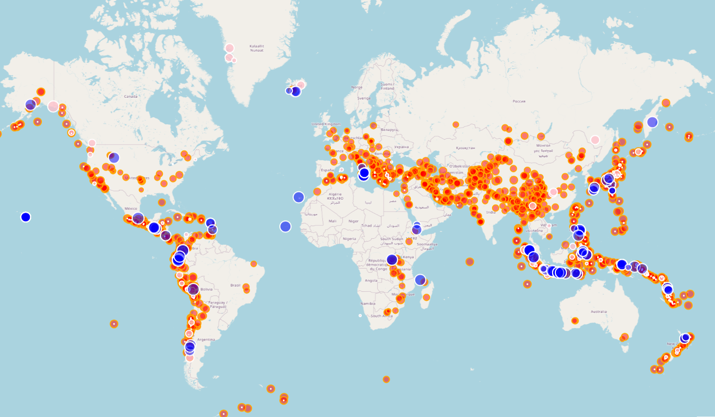
Slide 10
Layered Map
A map with several natural disaster layers allows one to:
visualize areas on the map where event types occur frequently
Visualize any areas where all three events occur
use tags to look at specific information for each individual event
10

Slide 18
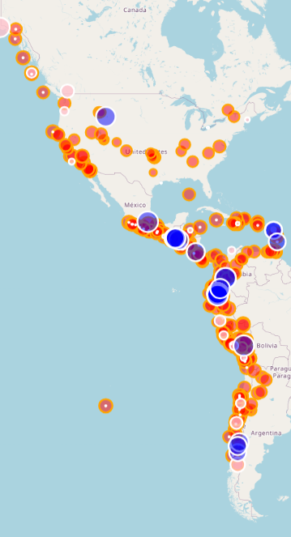
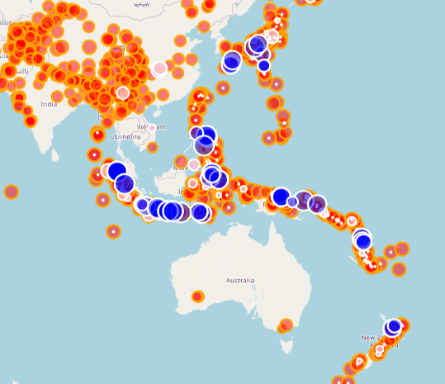
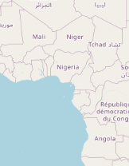
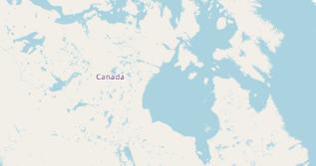
Activity Examples (2000-2024)
Lots of activity
Lots of activity
Lack of activity
Lack of activity
LIVE DEMO

Slide 19
Next Steps
Expanding the scope to include more years
Asking additional questions about our findings
Find another API that has similar data for other natural disasters, such as hurricanes or tornados
Explore if other nations that have datasets that are unique and can be used without ethical concerns

Slide 20

Slide 11
THANK YOU

